Slide 1
Unspent
Temporary Assistance to Needy Families (“welfare”) Block Grants: Nothing to spend it on?
Presented by Diane R. Pagen, LMSW
Social Worker
New York City

Slide 2
Temporary Assistance to Needy Families or TANF, the United States’ core income distribution program, created with the purpose of meeting basic human needs of families, in 2015 is now primarily:
a behavior modification program
b) a relatively unrestricted source of money for states to spend as desired on projects unrelated to poverty reduction, with a mechanism built in to increase the dollar amounts available to states
c) completely vulnerable to misuse as the federal government has devolved all responsibility to the states for their use of the grants

Slide 3
States are keeping significant amounts of their federal Temporary Assistance to Needy Families block grants at the end of each year.

Slide 4
WTF?

Slide 5
TANF Unspent block grant portions 2011-2013
 | 2011 | 2012 | 2013
Wyoming | $32,000,000 | $21,444,577 | $21,237,376
Tennessee | $60,000,000 | $20,474,496 | $59,303,874
Florida | $134,500,000 | $87,466,822 | $493,863
Urban Institute, Welfare Rules Databook, 2012

Slide 6
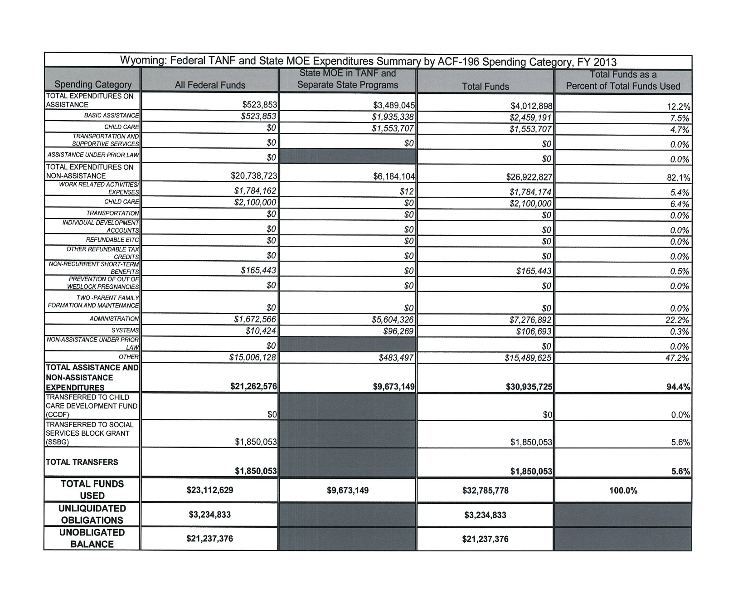

Slide 7
Wyoming (2013)
Population: 583,223
Population below FPL: 64,154
Wyoming TANF recipients:

Slide 8
Wyoming TANF caseload (individuals) 2013
674

Slide 9
Spent portion of block grant:
$32,785,778
Divided by 674 = $48,643.58 spent per TANF recipient annually
Unspent portion:
$21,237,376
Divided by 674 = $31,509.45
Only 11 percent of block grant is disbursed to eligible people as cash; the rest is spent in non-cash categories.
?

Slide 10
Adequacy (Asa Briggs)
Federal Poverty Line
vs.
State Standard of Need
vs.
maximum Monthly TANF Payment

Slide 11
What people need vs. what people get
 | FPL | State Standard of Need | Maximum monthly TANF benefit
Wyoming | $1590 | ---------------- | $602
Tennessee | $1590 | $1066 | $185
Florida | $1590 | $303 | $303
In these three states, maximum payment is the same for families with no other income source.
Urban Institute, Welfare Rules Databook, 2012

Slide 12
Purposes of TANF
TANF 2015
ADC 1935 (Aid to Dependent Children)
Provide a small income to needy families so that children can be cared for in their own homes.
Assisting needy families so that children can be cared for in their own homes.
Preventative measures for out of wedlock pregnancy
The encouragement of two parent families
The reduction of the dependency of needy parents by assisting with job preparation.

Slide 13

Behavior modification
TANF category spending, national totals*:
Prevention of out of wedlock pregnancies (including family cap in select states)
$1,088,089,290
Two parent family formation and maintenance
$192,988,042
Other
$2,148,235,351
*federal portion only, 2013
Two humans born to unwed parents before TANF

Slide 14
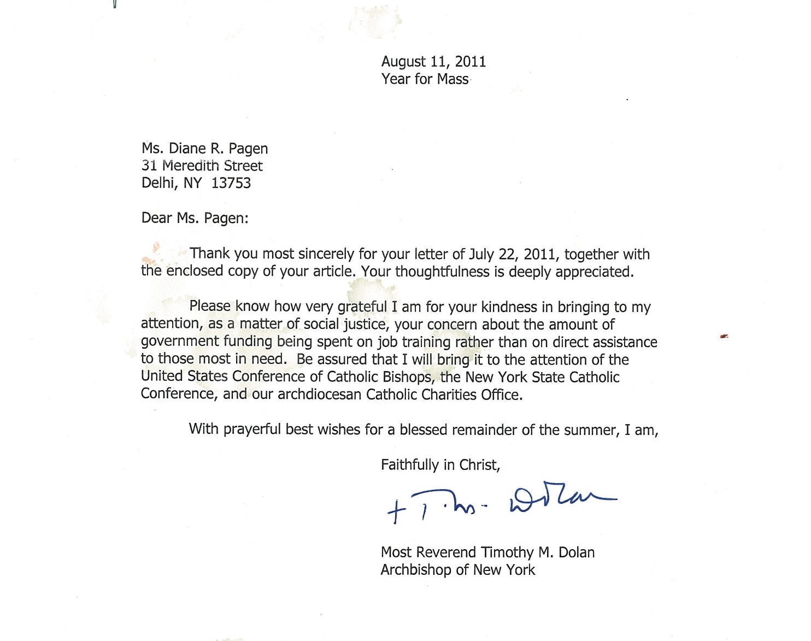
The bulk of block grant funds that are spent are spent for programs related to paid work, resume writing, etc.
In all three of the states shown as examples, more than 80 percent of the block grant is spent on non-cash, compulsory work activities.
Behavior modification

Slide 15
Hi, Diane -
Here are the responses to your questions. If you need additional clarification, please let us know. Have a wonderful weekend!
Sincerely,
Rachel Gwilliam
U.S. Administration for Children and Families
Washington, D.C.
If states don't have to return the money to the federal government, what tends to become of those funds?
The funds remain available to the state until they are spent.
How specifically have they been used in years they were unspent?
For most purposes, the funds can be spent in the same manner as current year block grant funds. The most notable exception is that “carryover” funds cannot be transferred. Prior to the Deficit Reduction Act of 2005, they could only be spent on “assistance.”
For example, in 2009 Florida had $6.9 million in unspent and unobligated TANF funds. Did they spend it and on what specifically? TANF categories? Something other then TANF but related to poverty? Then in 2012 Florida had $87 million unspent and unobligated. Did the unspent and unobligated from the prior years get figured into that $87 million, or is that $87 million only from 2012?
Generally, federal TANF and state MOE funds can be spent on a wide variety of activities, as long as they meet a TANF purpose (and for MOE are for individuals in an “eligible family”). We do not track state spending by current vs. carryover funds, but our website does have detailed information on state spending categories. For example, in FY 2013, the table on p. 30 shows the specific categories of expenditures in Florida; see: http://www.acf.hhs.gov/sites/default/files/ofa/fy_2013_expenditures.pdf. About one-third of Florida’s spending is in a category called “Other.” We have revised our financial data forms, effective FY 2015, to obtain more detailed information about spending categories. (my emphasis)
The next question is specific to Wyoming. Wyoming has 58,000 people with incomes below the federal poverty line in 2012. It had only 710 individuals enrolled in its TANF program. Its federal block grant was $44,300,000 in 2013, however. There seems to be both an irregularity in the percentage of Wyoming residents who are TANF recipients vs. the number of people income eligible that cannot be explained, even if we surmise that some of these people will be eligible for Supplemental Security Income or UI and other programs. Furthermore, the amount of its block grant seems disproportionate to the number of people the state of Wyoming serves. Is there an explanation for these two items? Does the state of Wyoming provide any explanation for this, and is there any consequence for the low uptake (enrollment) in terms of the next year's block grant size?
TANF was created in 1996 as a block grant. It gave states considerable flexibility to design their programs, including which families to target and how to use their funds. You will note on p. 71 of the above referenced website that Wyoming spends 12 percent of its funds on assistance; the remainder goes to other types of programs that serve low-income families and meet a TANF purpose. As to why the state has a low take-up rate, we suggest you contact the state.
The federal TANF block grant to Wyoming is derived from section 403 of the Social Security Act. The amount of each state family assistance grant (SFAG) remains constant unless there are reductions due to the implementation of a Tribal TANF program within the state. The federal TANF block grant is NOT adjusted based on increases or decreases in the caseload size.
My additional question as I asked it on the phone is whether the feds have sought to legislate any limitations, or new policy guidelines for states to set benefit levels closer to their own declared Standard of Need to address the erosion of the value of the benefit. Also, what is the federal position on family caps is the 21 states that have them, and isn't it a problem given that the family cap states refer pregnant women to abortion providers as an alternative to adding the child to their benefit case? Final question: Does the federal government have any policy proposal, legislation, etc. to address clearly in adequate state level policy such as the LA "flat grant" policy in setting benefit levels?
Congress created TANF as a block grant; the law specifically limited the role of the Executive Branch in section 417 of the Social Security Act: “No officer or employee of the Federal Government may regulate the conduct of States under this part or enforce any provision of this part, except to the extent expressly provided in this part.” Regarding an Administration backed legislative proposal on TANF standards of need, no such proposal has been introduced.

Slide 16
Q: The next question is specific to Wyoming. Wyoming has 58,000 people with incomes below the federal poverty line in 2012. It had only 710 individuals enrolled in its TANF program. Its federal block grant was $44,300,000 in 2013, however. There seems to be both an irregularity in the percentage of Wyoming residents who are TANF recipients vs. the number of people income eligible that cannot be explained, even if we surmise that some of these people will be eligible for Supplemental Security Income or UI and other programs. Furthermore, the amount of its block grant seems disproportionate to the number of people the state of Wyoming serves. Is there an explanation for these two items? Does the state of Wyoming provide any explanation for this, and is there any consequence for the low uptake (enrollment) in terms of the next year's block grant size?
A: TANF was created in 1996 as a block grant. It gave states considerable flexibility to design their programs, including which families to target and how to use their funds. You will note on p. 71 of the above referenced website that Wyoming spends 12 percent of its funds on assistance; the remainder goes to other types of programs that serve low-income families and meet a TANF purpose. As to why the state has a low take-up rate, we suggest you contact the state.
The federal TANF block grant to Wyoming is derived from section 403 of the Social Security Act. The amount of each state family assistance grant (SFAG) remains constant unless there are reductions due to the implementation of a Tribal TANF program within the state. The federal TANF block grant is NOT adjusted based on increases or decreases in the caseload size.

Slide 17
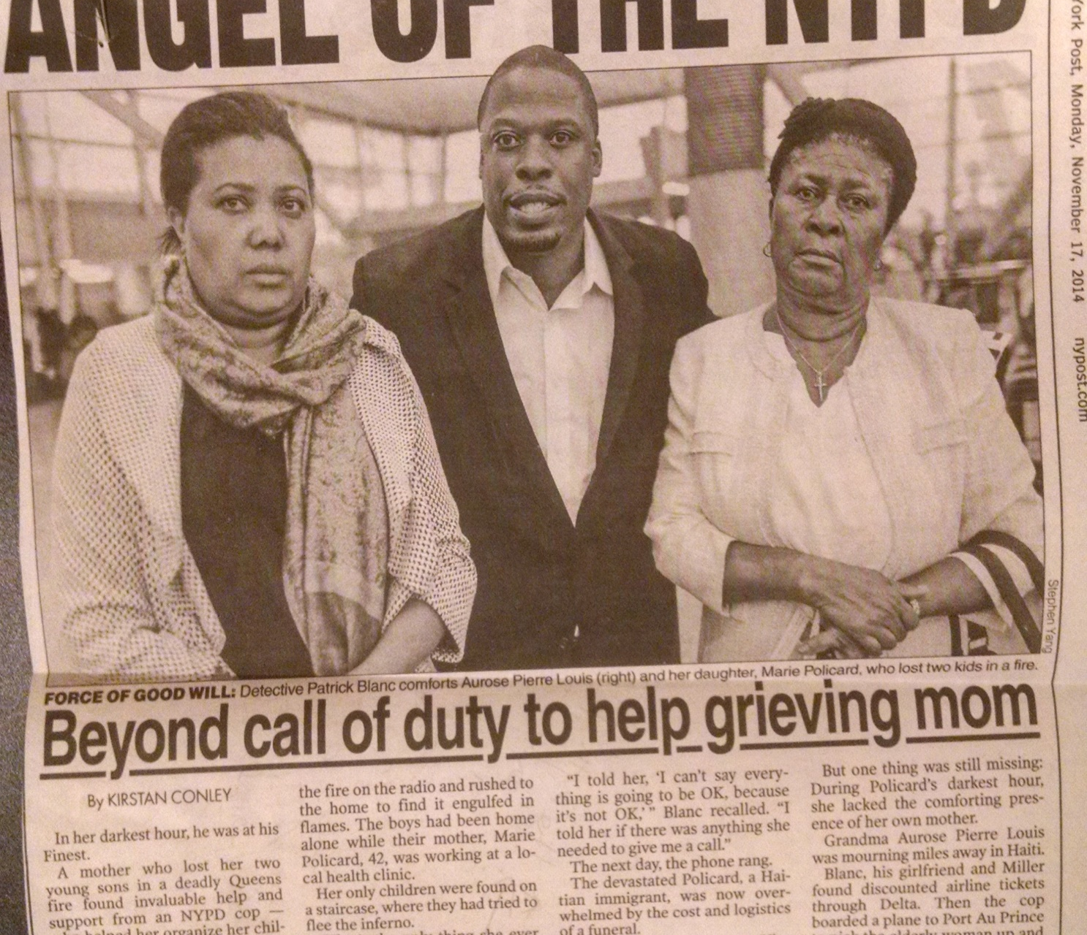
One effect of low TANF uptake and inadequate cash assistance: Child deaths
Unattended candles and smoke detectors both missing and inoperative are being blamed in the deaths Monday night of two St. Albans children who were alone when a fire broke out in their Tioga Drive home.
“All too often our members respond to fires where our children are victims,” FDNY Commissioner Daniel Nigro said. “Our mission is to make certain all New Yorkers learn from this tragedy and obtain working smoke detectors for their home.”

Slide 18
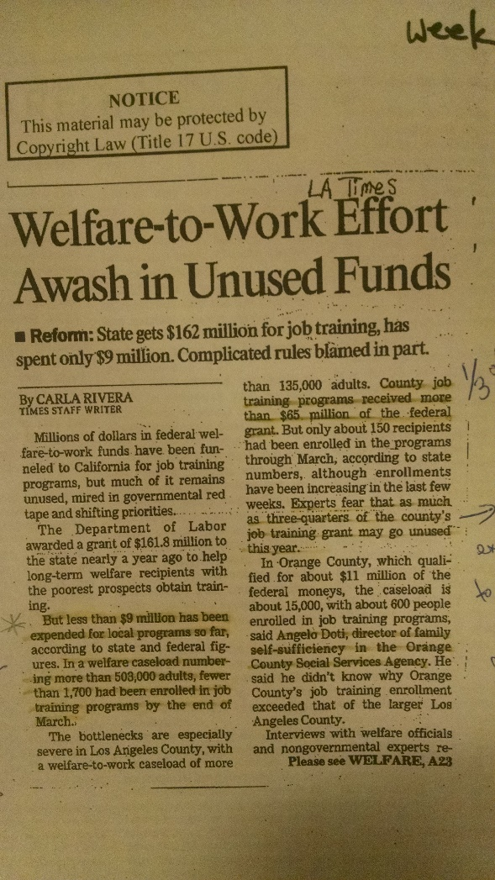
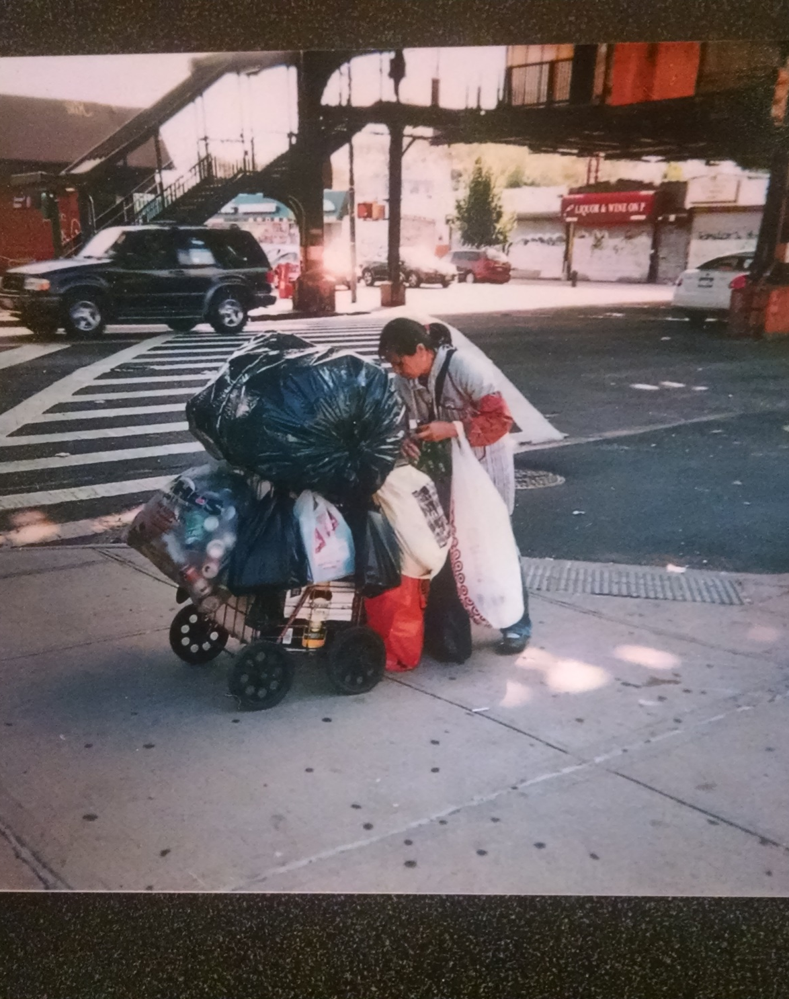
Portions of TANF block grants go unspent in nearly every state, going back several years.
California, 2002 →
←New York, 2013
$104 million

Slide 19
No guarantee of assistance,
even for those proven eligible
Even if a family passes all eligibility tests, in some states the family may not qualify for a positive benefit under that state’s benefit computation formula. In those cases, the family will not receive a benefit*
* Urban Institute, Welfare Rules Databook 2012

Slide 20
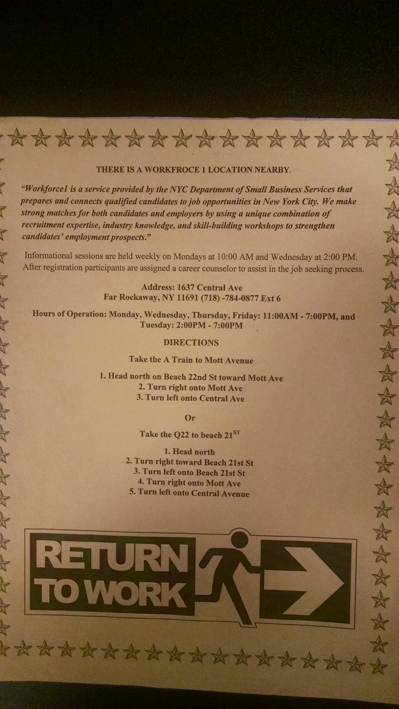
What to do for poor people when your country won’t distribute income, #1:
Job training, job searching, job readiness, job skills, work activities, resume writing….

Slide 21
What to do when your country won’t distribute income #2
Once a year, give away turkeys and coats. Give the federal funds you could have used to give people income to charities so they can give away turkeys and coats.
Illustration by Nathan Schreiber

Slide 22

What to do when your country won’t distribute income #3
Convince people living on TANF benefits pegged at 10-50 percent of the poverty line that they just need to learn how to manage their money better.
(Wyoming: $602, 41 percent of FPL)

Slide 23
What to do when your country won’t distribute income #4
Encourage poor people to recycle as a viable replacement for an adequate national income distribution program.

Slide 24
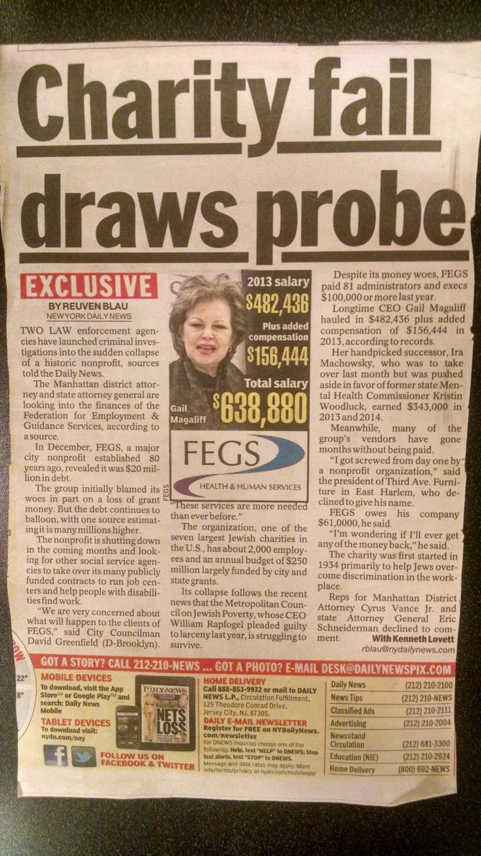
Give public money to charities and let them help poor people.
“ FEGS, a New York City-based social service organization, will not say when or how it learned of the $19.4 million loss. Nor will FEGS do more than provide a list of vague explanations as to how its fiscal house fell into such exceptional disorder… FEGS serves over 100,000 people a year in New York with programs that aid the disabled, the sick and the unemployed of all backgrounds. Those programs are funded, in large part, by public money: FEGS reported receiving $94 million in government grants in 2013, a figure that doesn’t even include payments from government programs like Medicaid.”
--The Forward, December 17, 2014

Slide 25
Strategies to get along without an income safety net
Borrow your social worker’s unlimited Metrocard.
Pretend your Metrocard doesn’t work.
Double up with another family in a two bedroom apt.
Frequent food banks (their budgets are 98 percent public money anyway)
Steal sandwiches from busy Manhattan eateries that are too chaotic to notice.

Slide 26
The Dastardly Plan
⌂ Continue to increase restrictions on eligibility so that caseloads continue to shrink.
⌂ Remove guarantee of aid, even to people who meet all eligibility requirements.
⌂ The 1996 PRWORA law allows each state to keep their TANF block grant unspent funds regardless of numbers of people in poverty or documented unmet need.
⌂ Continue to mislead people into thinking that reducing the welfare roles saves taxpayer money.

Slide 27
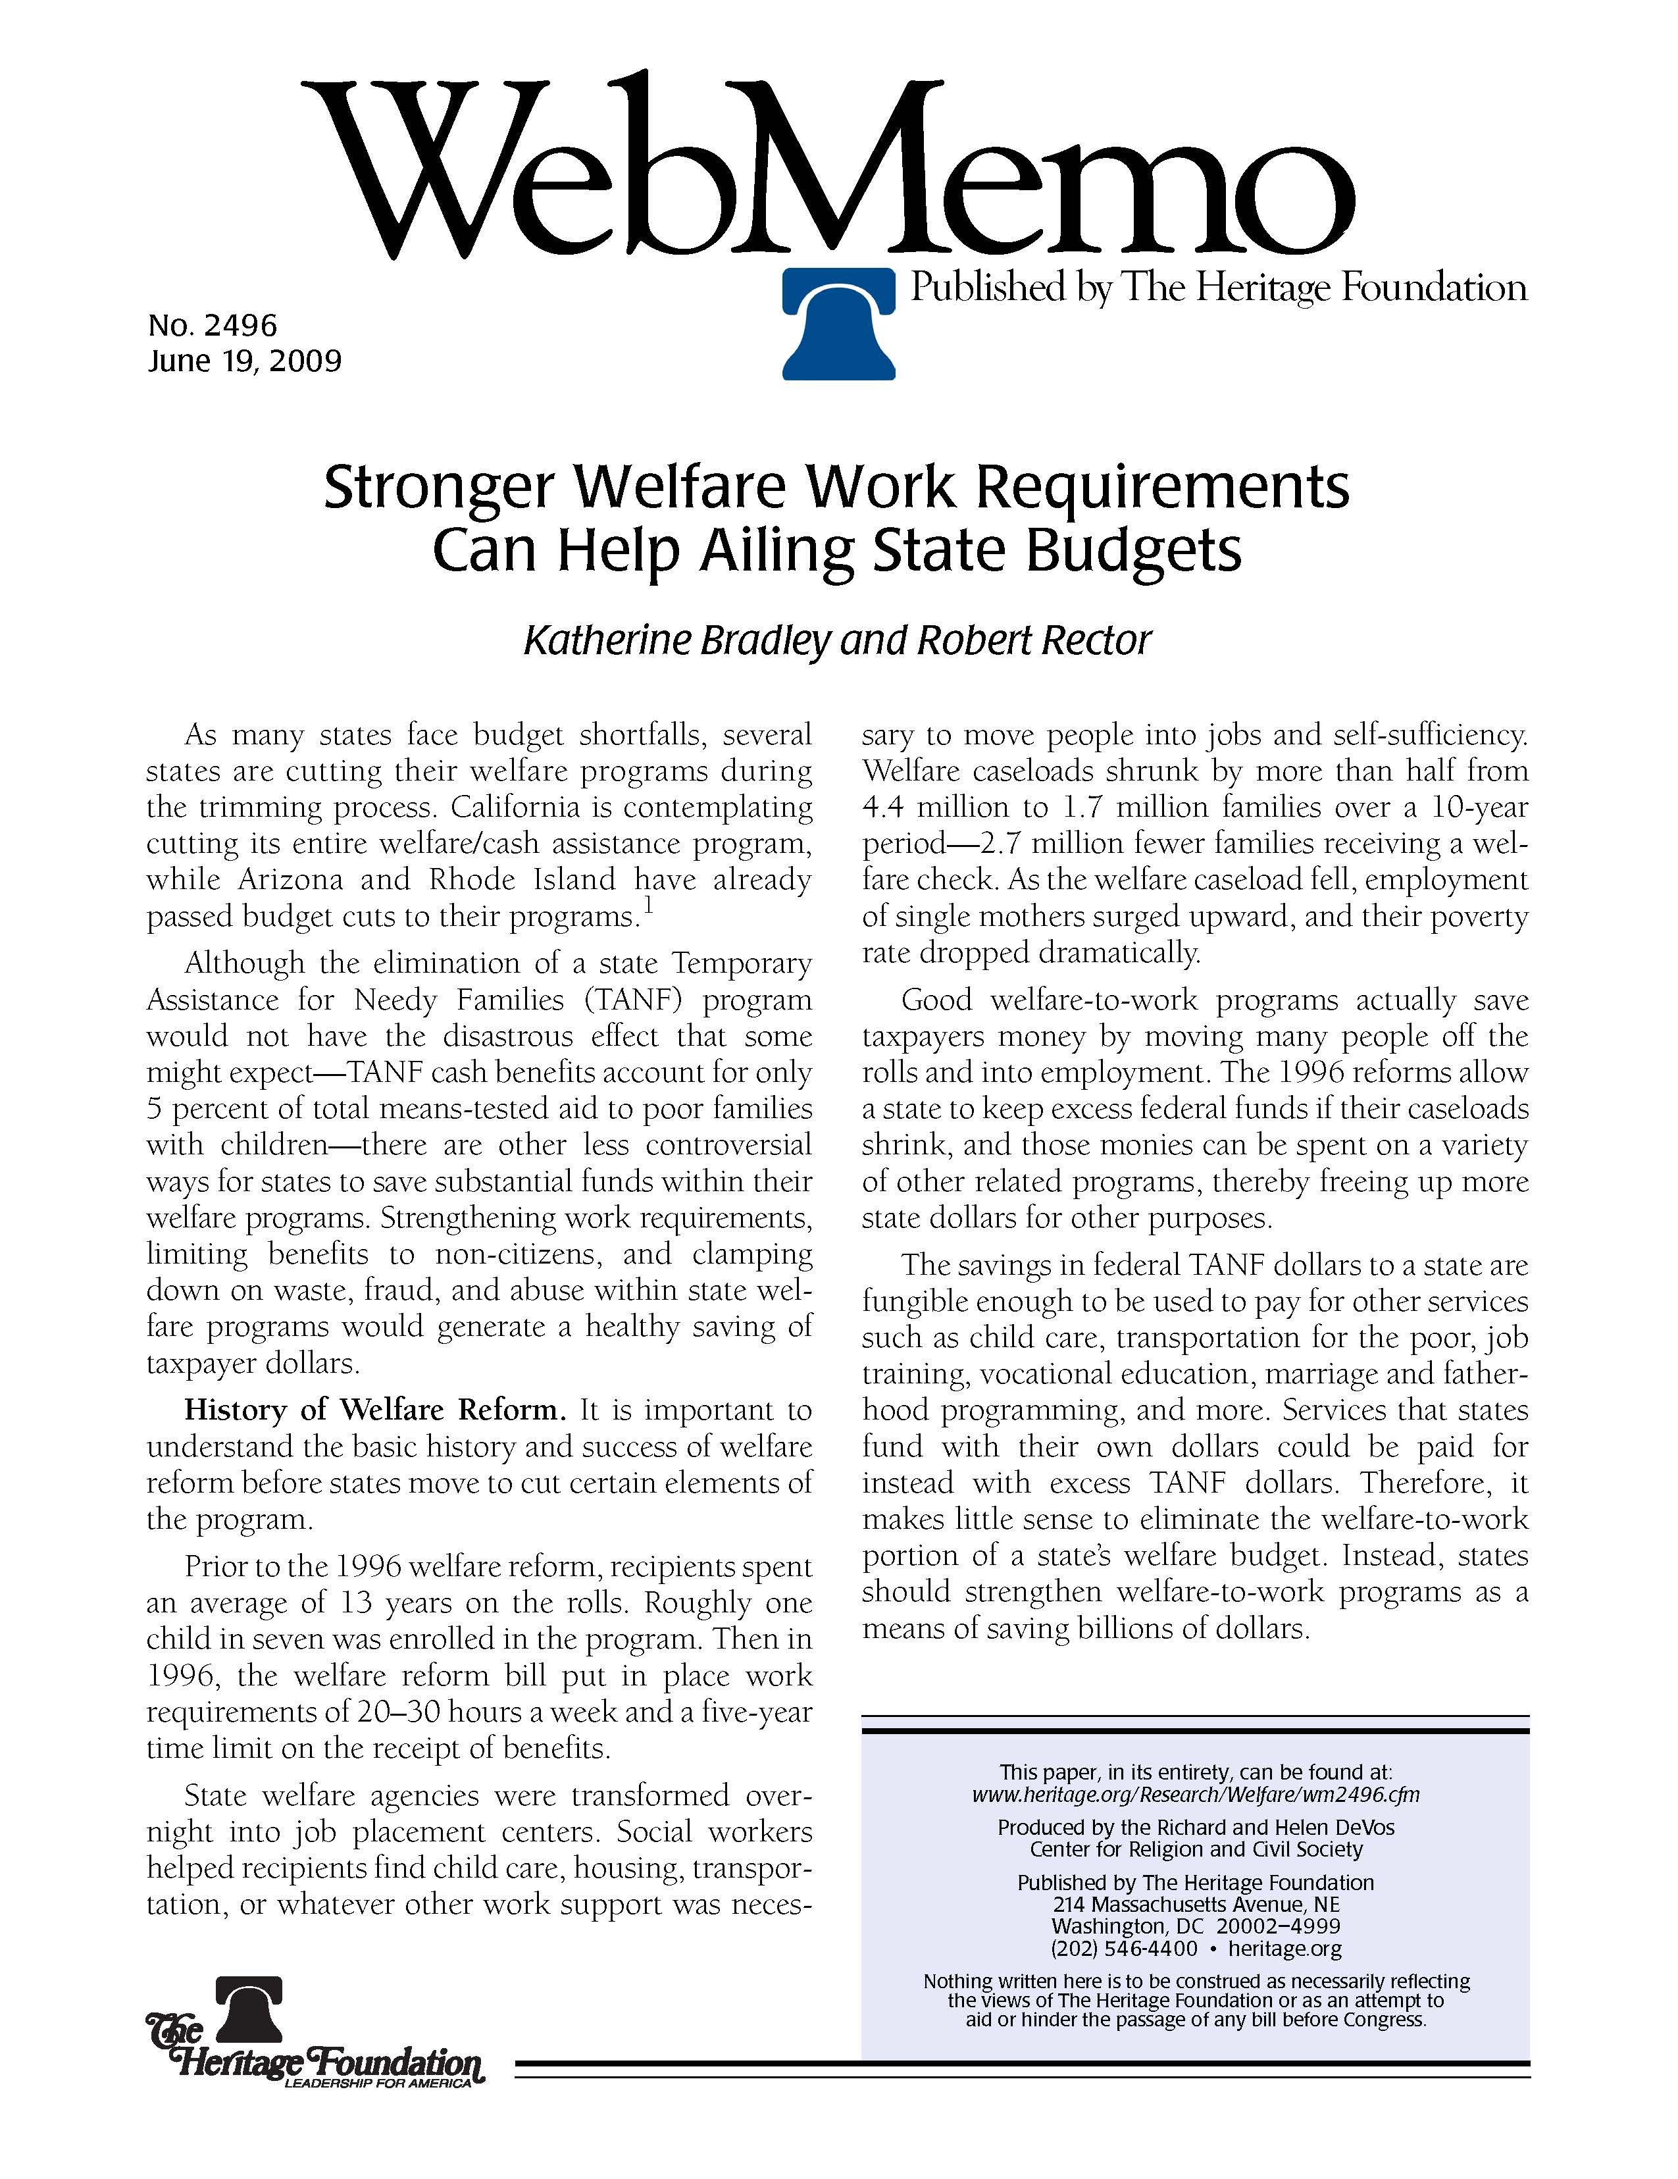
Heritage Foundation
2009, Center for Religion and Civil Society
In this paper and others, Robert Rector specifically supports keeping TANF despite being “anti-welfare,” so that states can use the block grants as they wish.
In the press, however, conservative legislators tell the public they are saving taxpayers money every time someone leaves the welfare rolls. As we saw from Rachel Gwilliam’s information, this is clearly untrue, since the block grant size isn’t reduced when the caseload falls.
Waste, fraud and abuse by individuals vs. waste, fraud and abuse by states.

Slide 28
No guarantee of assistance,
even for those proven eligible
Behavior modification has become the main purpose of the program, not income support. America is spending billions of dollars a year on a massive behavior modification program that is anti-child, anti-gay, and anti-woman.
Large bureaucracy and infrastructure are being funded to deliver aid to tiny percentages of all Americans in need
States are fully aware that their benefit levels are inadequate and that they reach only a small portion of poor people
The present system encourages waste, fraud and abuse by local legislators and state governments.

